Slide 1
Advanced methods of
molecular dynamics
Lecture room of KCHFO MFF UK,
Ke Karlovu 3, Wednesday 9 – 10:30
    Pavel Jungwirth
    Ústav organické chemie a biochemie
    Akademie věd České republiky
    Flemingovo nám. 2, 166 10 Praha 6
    tel.: 220 410 314
    FAX: 220 410 320
    e-mail: pavel.jungwirth@uochb.cas.cz
    www.molecular.cz/~jungwirt

Slide 2
Advanced methods of
molecular dynamics
Monte Carlo methods
Free energy calculations
Ab initio molecular dynamics
Quantum molecular dynamics
Trajectory analysis

Slide 3
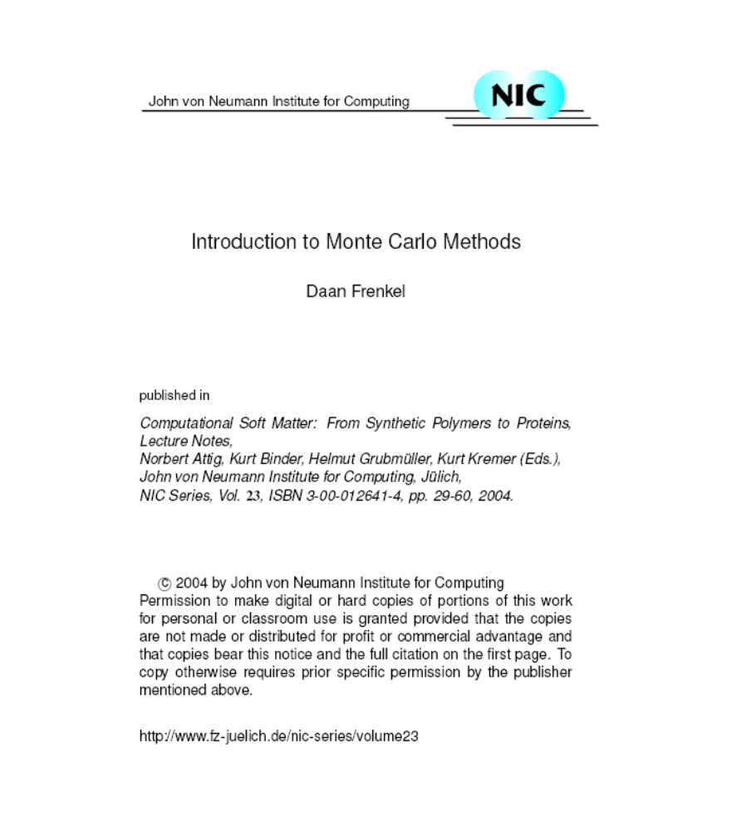
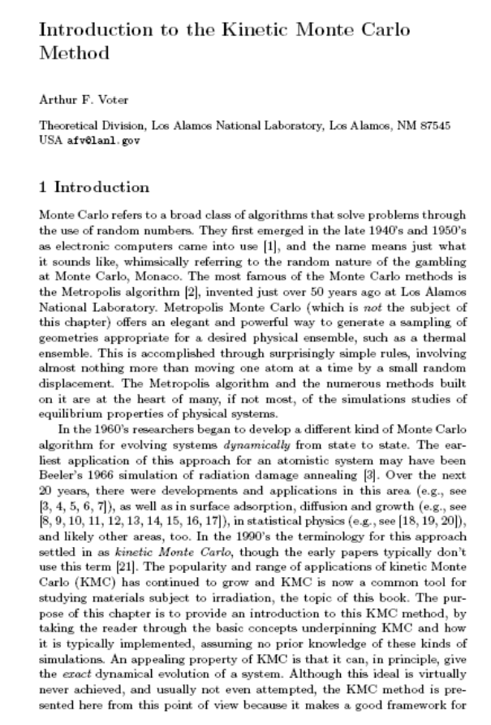
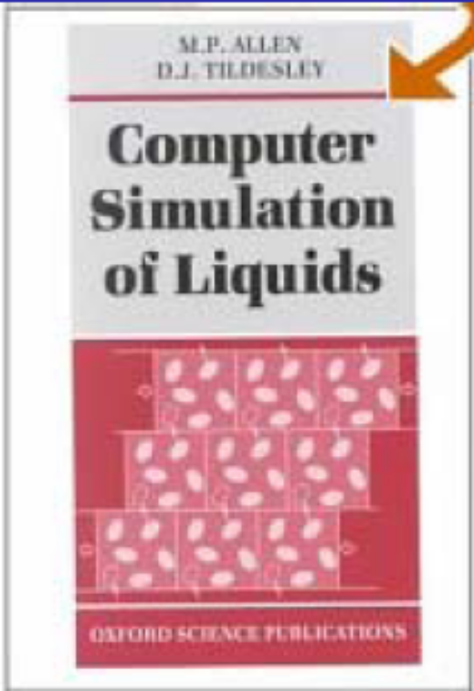

Literature: ad 1)
M. P. Allen &
D. J. Tildesley
Computer simulation
Of liquids
Clarendon Press,
Oxford, 2006.

Slide 4
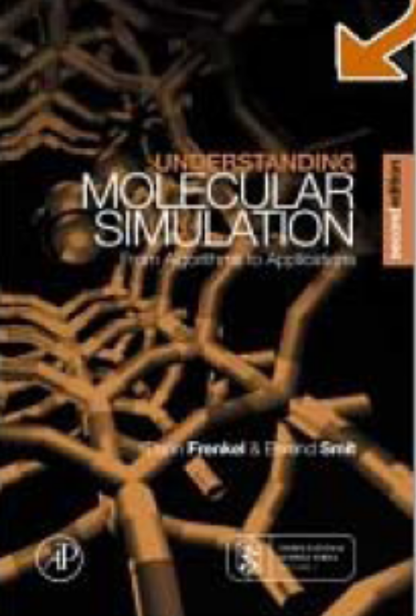
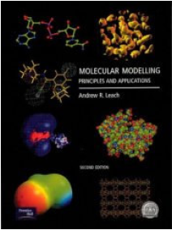
Literature: ad 2)
M. P. Allen &
D. J. Tildesley
Computer simulation
Of liquids
Clarendon Press,
Oxford, 2006.
D. Frenkel & B. Smit
Understanding molecular
simulation
Academic Press,
New York, 1996
R. Leach
Molecular Modelling
AIP, Dorchester, 2001.

Slide 5
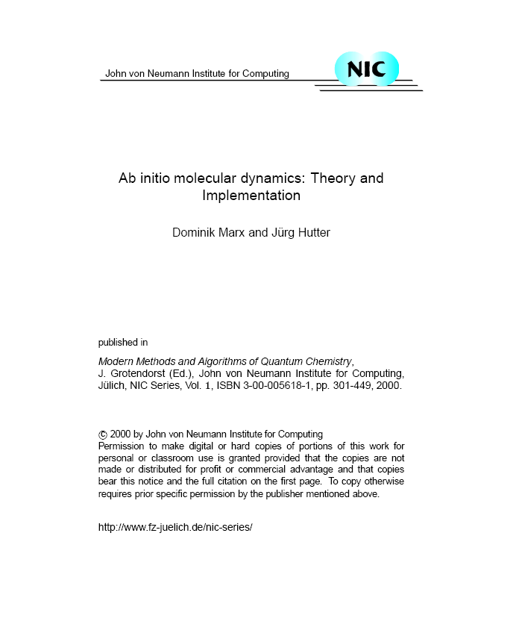
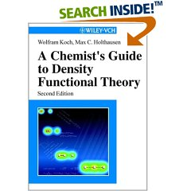
Literature: ad 3)
W. Koch & M. C. Holthausen
A chemist’s guide to density
functional theory
Wiley, New York, 2001

Slide 6
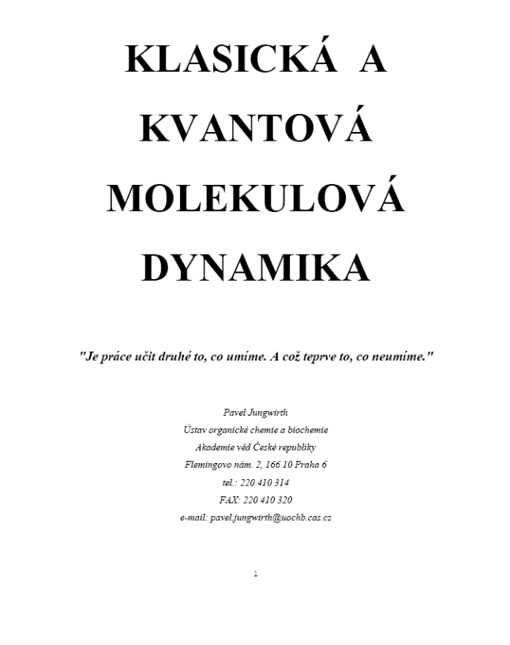
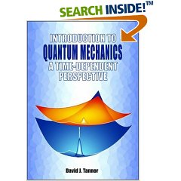
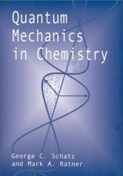
Literature: 4)
D. J. Tannor
Introduction to quantum
mechanics: A time-
dependent perspective
University Science Books,
San Diego, 2007.
www.molecular.cz/
~jungwirt
G. C. Schatz & M. A. Ratner
Quantum mechanics in chemistry
(Chapter 9)
Prentice Hall, London, 1993.

Slide 7
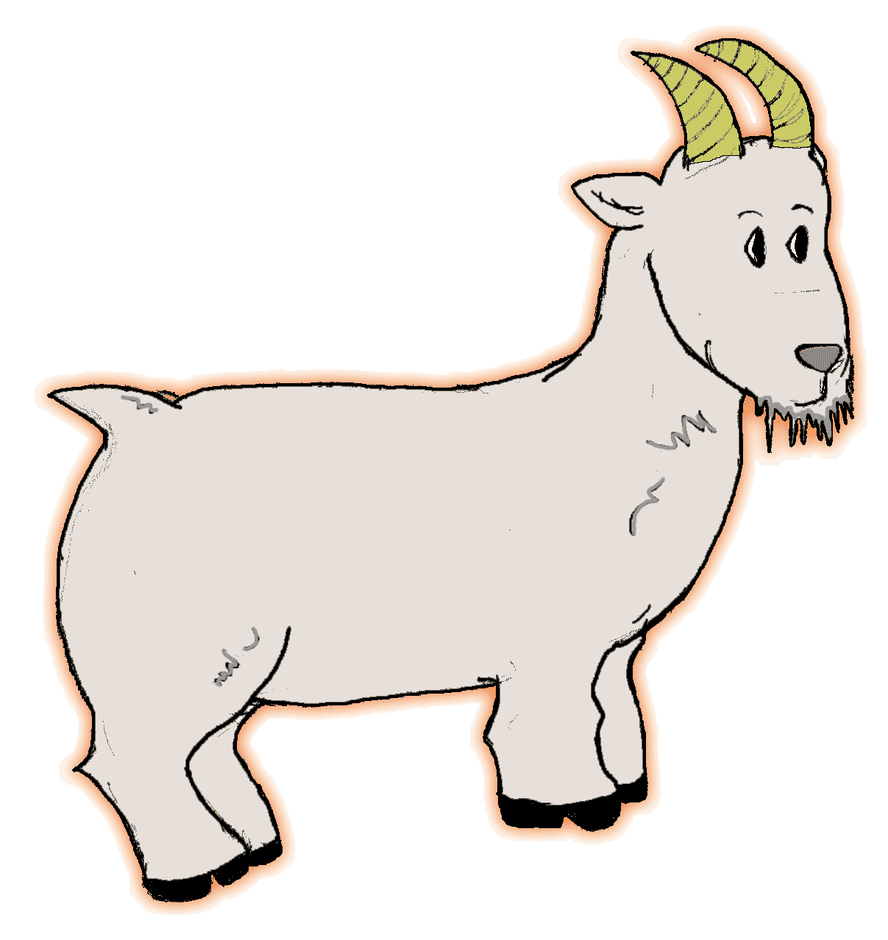
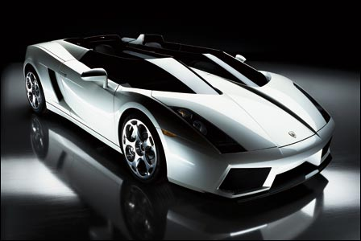
Computer simulation without computer:
Advanced example I
You are participating on a TV show. The moderator shows you 3
doors and says that behind one of them there is a car, while
behind each of the other two there is a goat. You point your finger
to one of the doors and the moderator (who knows where is what)
then opens another door where there is a goat.
He then gives you a chance to change your choice.
Question: Shall you change your mind and point to another door
in order to increase your chance to win the car of your dreams?
or or

Slide 8
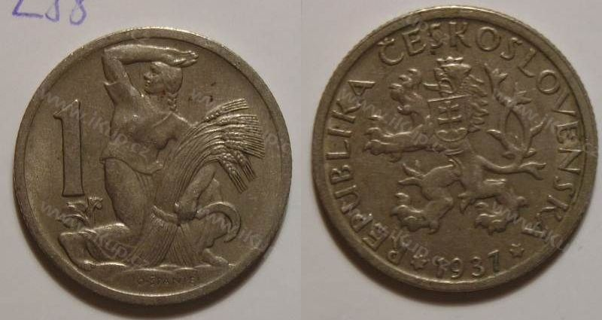
Computer simulation without computer:
Advanced example II
If a coin is flipped until head appears, what is the probability
that head first shows up on an odd-numbered trial?
…???
Solve it first numerically using Monte Carlo – flipping coins…
…then try to find analytic solution!

Slide 9
Analytic solution
P = 0.5 + 0.5x0.5x0.5 + 0.5x0.5x0.5x0.5x0.5 + …
1st 3rd 5th … trial
P = 1/2 + 1/8 + 1/32 + … = 2/3 = 0.66666…
P = 0.5x(1 – 0.25n)/(1 – 0.25), n → ∞
What is the probability for even-numbered trials?
Of course 1/3 (= 1 – 2/3)

Slide 10
Homework problem:
Variation on example I
You and your buddy were sentenced to death. Before the
execution a guard comes with a bag with three marbles of
different colors (either black or white) and says:
“If you guess the color of a marble you take out I spare your life.”
Your first buddy says “white” and pulls out a white marble. He
is saved! Now is your turn – shall you say “white”, “black”,
or it does not matter?
Solve it using Monte Carlo (with real marbles or writing a short
program) and then try to solve it analytically!
Correct answer: If you say “black” you have 2/3 chance to survive, if “white only 1/3 chance.

Slide 11
Computer simulations
Experiment Simulation Theory
Experimental Simulation results Predictions of analytical
results theories
Comparison of predictions and results…
Test of simulation models!
Test of approximate theories!
Test of experient?

Slide 12
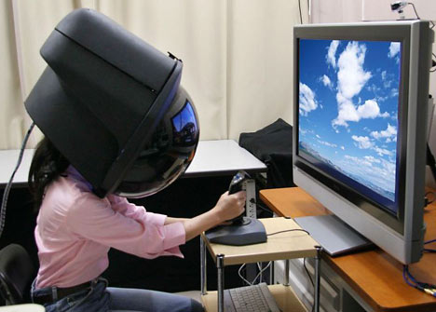
Výhody počítačových simulací
Advantages of simulations
study of systems at extreme conditions
(high temperatures or pressures).
time and space resolution inaccesible
to experiment,
CHEAP (Moor’s law).
But beware – it is „virtual reality“!

Slide 13
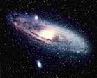
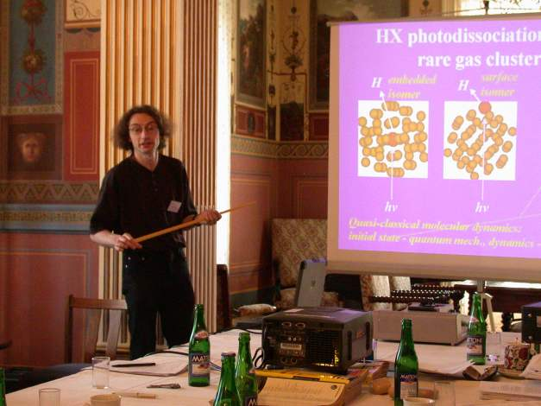
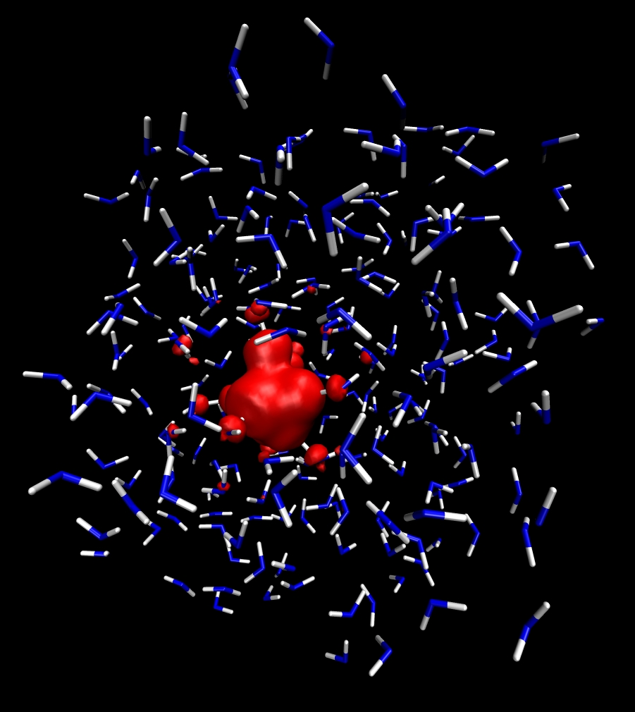
Kde se používají počítačové simulace?
Studied systems
Macroworld:
stars, galaxies, …
Mesoworld:
lecturer, students...
Microworld:
atoms and molecules.

Slide 14

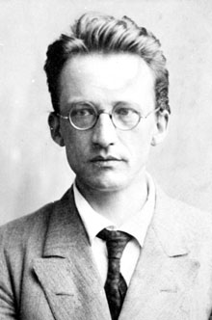
Eqations of motion
Solved numrically for systems composed of atoms…
Newton’s laws of motion – classical molecular dynamics.
Schrödinger equation – quantum molecular dynamics.
Necessary condition – interaction potential.

Slide 15
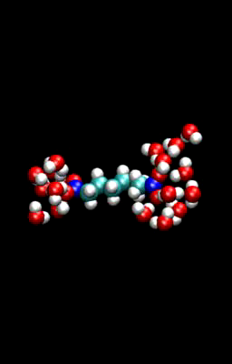
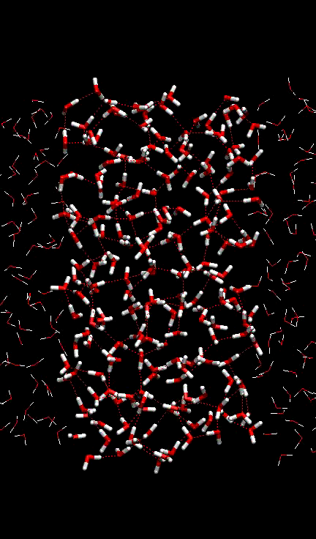
Dynamické simulace
Non-equilibrium processes
Folding of a suberate dianion
In a cluster with 18 waters.
Homogeneous freezing
of a slab of water.

Slide 16
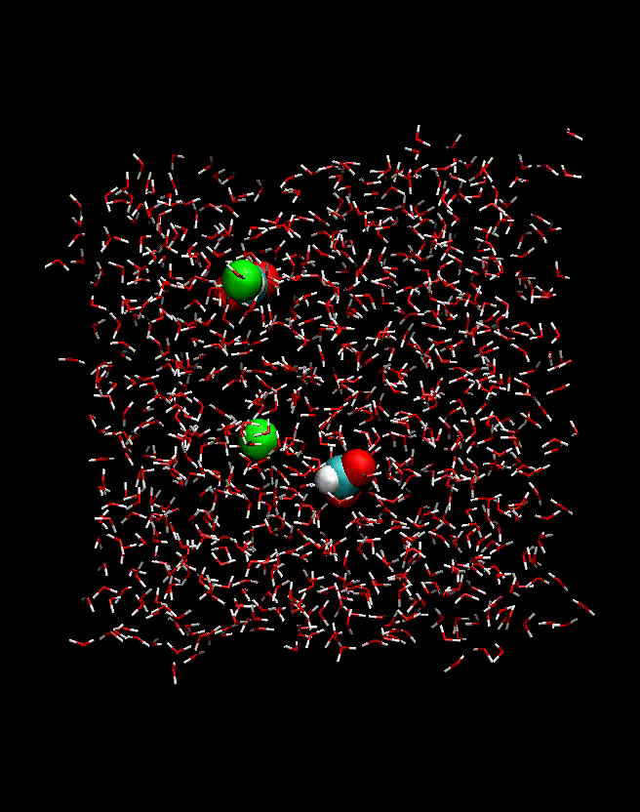
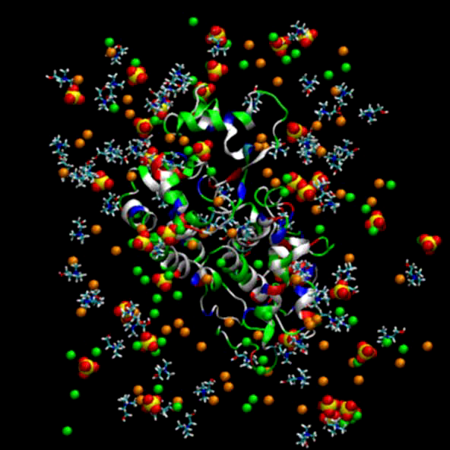
Equilibrium processes
Dissoltion of sodium formate
in a slab of water.
Interaction of a model protein with salt ions
in water (water molecules not depicted)

